Slide 1
Final Project
Jason Block
EECT 111
Professor Alba Betancourt

Slide 2
Using MultiSim, Excel and hand calculations create a set of notes that show how to:
1.) Multiple resistors combine in series and parallel.
2.) By example calculate R_{T}, I_{T}, P_{T}, and all the nodal voltages, branch currents and power
dissipation of a resistor network.
3.) By example calculate the Thevenin Resistance and Voltage of a resistor network.
4.) Multiple capacitors combine in series and parallel.
5.) Multiple inductors combine in series and parallel.
6.) Using a simple RC circuit determine the
a.) Time Constant
b.) Create a graph that shows the RC time constant as a function of time
c.) Determine X_{C} at a fixed frequency
d.) Create a graph that shows how X_{C} changes as a function of frequency
7.) Using a simple RL circuit determine the
a.) Time Constant
b.) Create a graph that shows the RL time constant as a function of time
c.) Determine X_{L} at a fixed frequency
d.) Create a graph that shows how X_{L} changes as a function of frequency

Slide 3
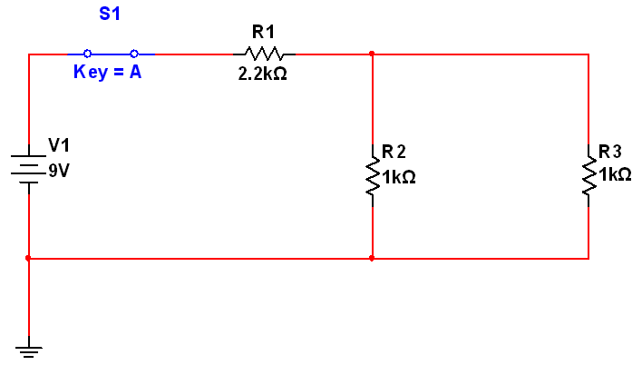
Problem 1

Slide 4
Problem 2
* using circuit from problem 1
RT = R1 + (1/(1/R2+1/R3)) = 2.2 + (1/(1/1 + 1/1)) RT = 2.2 + .5 = 2.7k ohm
IT = Vt/Rt = 9V/2.7k ohm = 3.33 amps
PT = VT * IT = 9V * 3.33 amps = 29.97 watts
VR1 = IR1 * R1 = 3.33 amps * 2.2k ohms = 7.326 V
VR2 = IR2 * R2 = 1.665 amps * 1 k ohm = 1.665V
VR3 = IR3 * R3 = 1.665 amps * 1 k ohm = 1.665V
IR1 = IT = 3.33amps
IR2 = R3/(R2+R3) * IT = 1 k ohms/(1 k ohms + 1 k ohms) * 3.33 amps = 1.665 amps
IR3 = R2/(R3+R2) * IT = 1 k ohms/(1 k ohms + 1 k ohms) * 3.33 amps = 1.665 amps
PR1 = VR1 * IR1 = 7.326 V * 2.2 k ohms = 16.117 watts
PR2 = VR2 * IR2 = 1.665 V * 1 k ohm = 1.665 watts
PR3 = VR3 * IR3 = 1.665 V * 1 k ohm = 1.665 watts

Slide 5
Problem 3

Slide 6
Problem 3 – cont.
R1 ll R2 = 40 Ω / 2 =20 Ω
R4 ll R5 = 20Ω / 2 = 10 Ω
R12 + R3 + R45 = RT = 20 Ω + 10 Ω + 10 Ω = 40 Ω
V12 = .225 / 2 * 40 Ω = 4.5V
V3 = .225 * 10 Ω = 2.25V
V45 = .225 / 2 *20 Ω = 2.25V
4.5V + 2.25V + 2.25V = 9V
Vs = V12 + V3 + V45 = Vs = 9V
I = V / R = 4.5 V / 110 Ω = 40.909mA
Vth = 2.25 V * 2 = 4.5V
Rth = 10 Ω

Slide 7
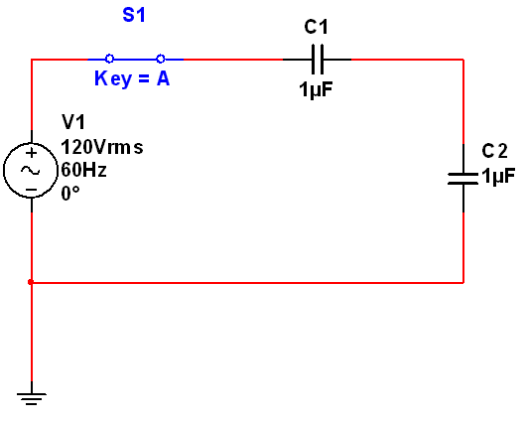
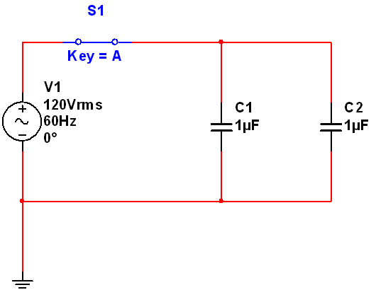
Problem 4
Series
Parallel

Slide 8
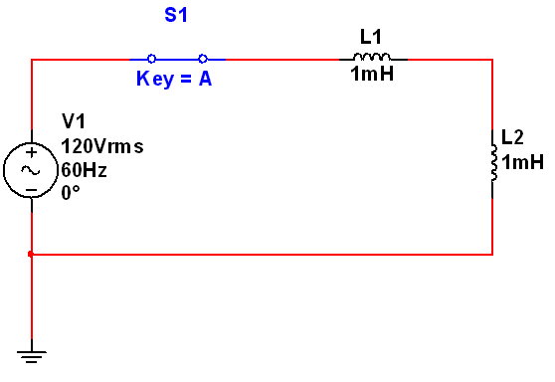
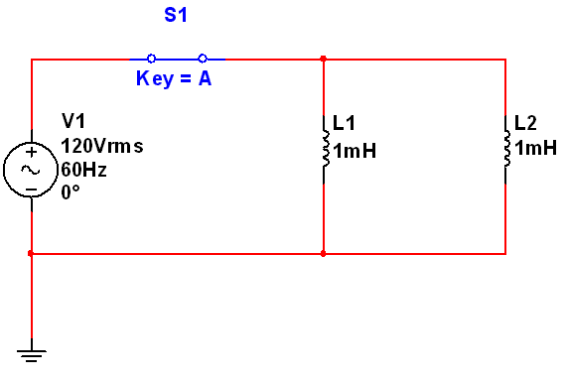
Problem 5

Slide 9
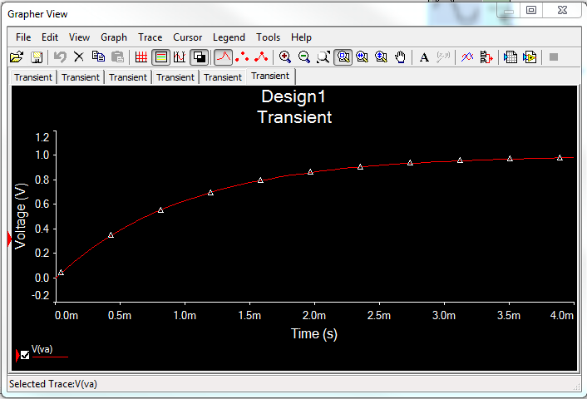
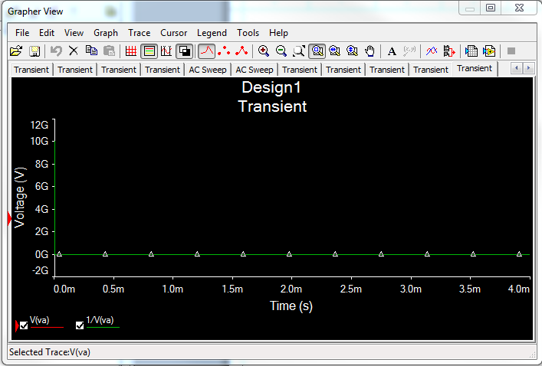
Problem 6
Time constant
  τ = R * C = 1k ohm * 1 µF = .001 seconds
  Xc = 2πfC = 6.28 * 60Hz * 1µF = 2.653 k ohm

Slide 10
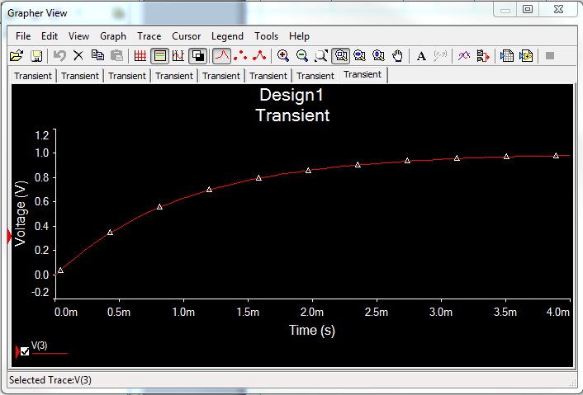
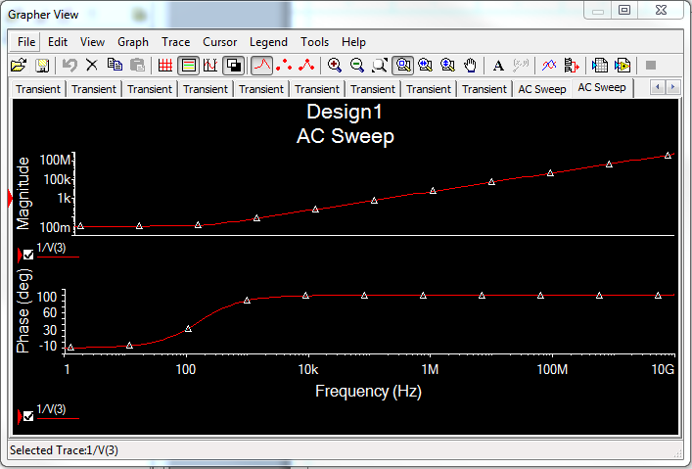
Problem 7
Time Constant
  τ = L/R = 1mH / 1 k ohm = 1 millisecond
  XL = 2πfL = 6.28 * 60Hz * 1mH = .377 ohms

